Slide 1
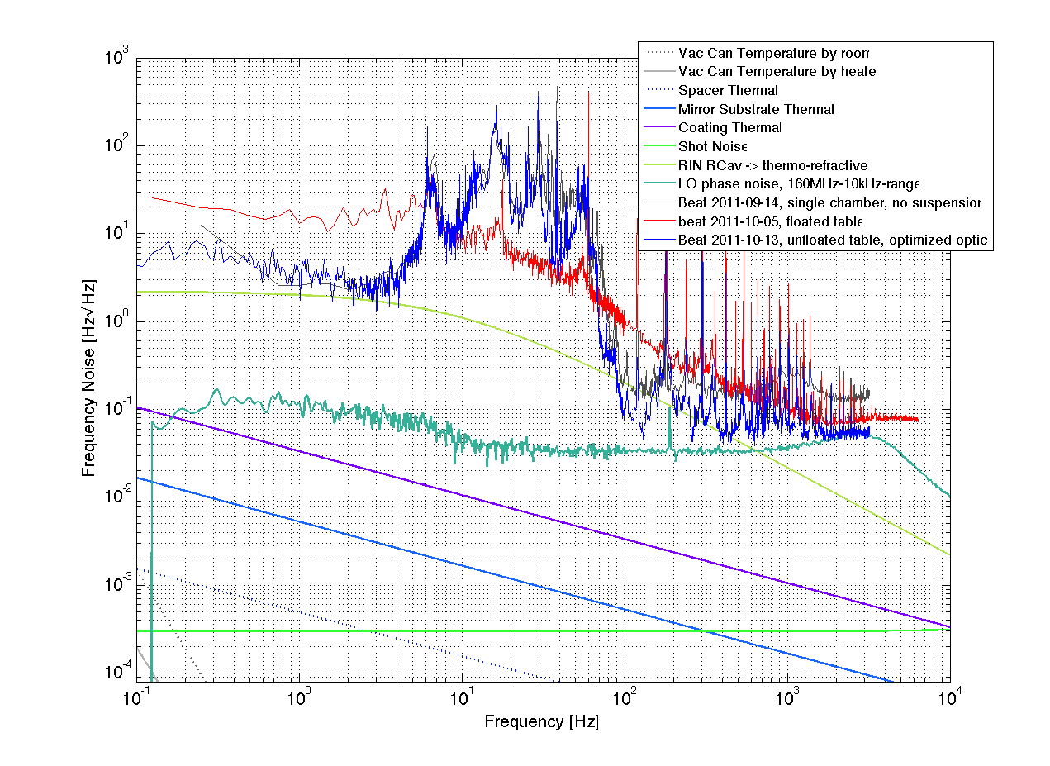
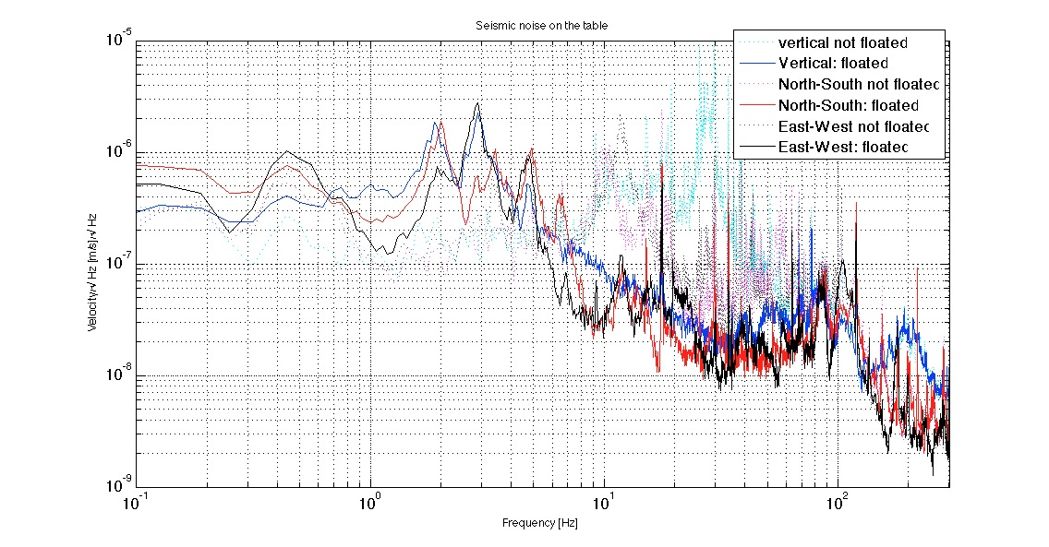
PSL Lab
Result
dvz=2e-6 m/s/rtHz
df=80Hz/rtHz
(@28Hz)
➔
(df/f)/g=7e-9

Slide 2
Spherical reference cavities for frequency stabilization of lasers in non-laboratory environments
Vol. 19, No. 4 / OPTICS EXPRESS 3471
David R. Leibrandt,* Michael J. Thorpe, Mark Notcutt,
Robert E. Drullinger, Till Rosenband, and James C. Bergquist
(df/f)/g = 4e-11 ~ 3e-10

Slide 3
Field-test of a robust, portable, frequency-stable laser
David R. Leibrandt,* Michael J. Thorpe, James C. Bergquist, and Till Rosenband
Vol. 19, No. 11 / OPTICS EXPRESS 10278
(df/f)/g = 4.0/16/31 × 10−11 /g
with active feed-forward
(df/f)/g = 1.1/0.6/0.4 × 10−11/g

Slide 4
Force-insensitive optical cavity
Stephen Webster* and Patrick Gill
OPTICS LETTERS / Vol. 36, No. 18 / 3572

Slide 5
(df/f)/g = 2.45/0.21/0.01 × 10−11 /g

Slide 6
PHYSICAL REVIEW A 74, 053801 (2006)
Vibration-induced elastic deformation of Fabry-Perot cavities
Lisheng Chen,* John L. Hall, and Jun Ye
Tao Yang, Erjun Zang, and Tianchu LiDavid R. Leibrandt,* Michael J. Thorpe, James C. Bergquist, and Till Rosenband
(df/f)/g = 2 × 10−9 /g

Slide 7
PHYSICAL REVIEW A 74, 053801 (2006)
Vibration-induced elastic deformation of Fabry-Perot cavities
Lisheng Chen,* John L. Hall, and Jun Ye
Tao Yang, Erjun Zang, and Tianchu LiDavid R. Leibrandt,* Michael J. Thorpe, James C. Bergquist, and Till Rosenband
(df/f)/g = 7 × 10−11 /g

Slide 8
Appl. Phys. B 83, 531–536 (2006)
Vibration-insensitive reference cavity for an ultra-narrow-linewidth laser
T. Nazarovau, F. Riehle, U. Sterr
PHYSICAL REVIEW A 79, 053829 (2009)
Ultrastable lasers based on vibration insensitive cavities
J. Millo, D. V. Magalhães, C. Mandache, Y. Le Coq, E. M. L. English,* P. G. Westergaard, J. Lodewyck, S. Bize, P. Lemonde, and G. Santarelli
(df/f)/g = 3.0/0.32/0.24 × 10−10 /g
(df/f)/g = 1.5 × 10−10 /g

