Slide 1
Higher-order Fluctuation Relation
https://journals.aps.org/prl/abstract/10.1103/PhysRevLett.104.080602

Slide 2
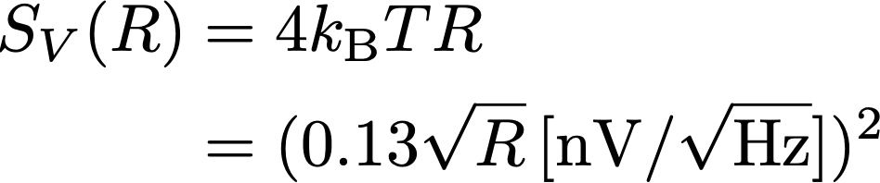
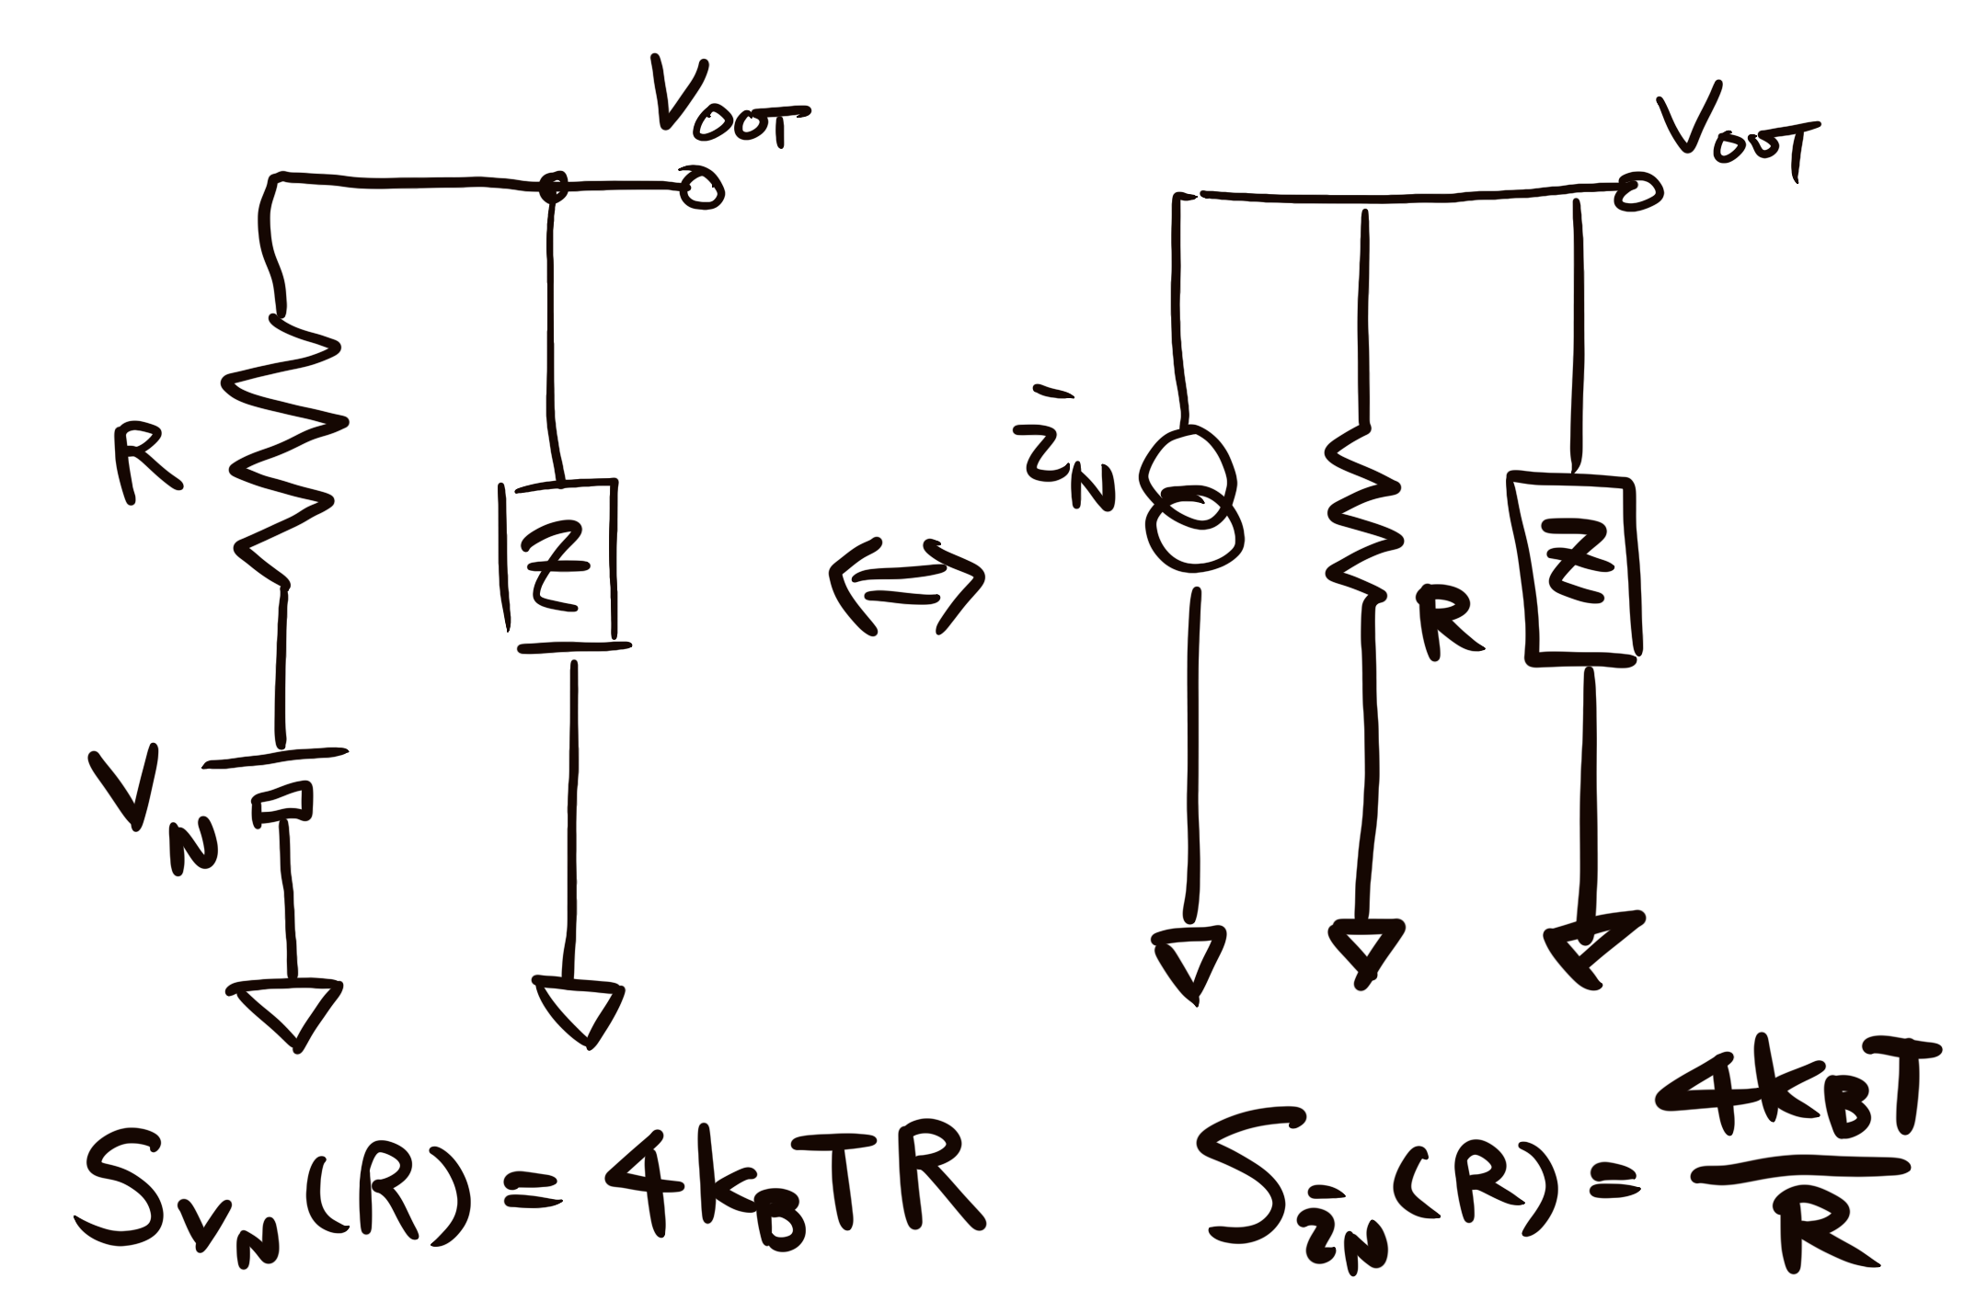
Thermal noise of a resister
Johnson-Nyquist Noise
Equivalence of the voltage noise and the current noise
V
R
Notes:
S_V(R) &= 4 k_{\rm B} T R\\
& = (0.13 \sqrt{R}\,{\rm [nV/\sqrt{Hz}]})^2

Slide 3
Thermal noise of a nonlinear device
Nonlinear conductor
We usually don't care if a device is a resister, a semiconductor, a mechanical device, or whatever.
How S(V) will be when I is nonlinear?
e.g S1(Gi), S2(Gi)...?
Notes:
{\rm FDT:}\, S_0 = 4 k_{\rm B} T G_1

Slide 4


AB ring as a nonlinear conductor
Aharonov-Bohm ring
Fig1
GaAs/AlGaAs
heterostructure
with local oxidation
electron wave
IFO
DC Gate V
(tuning param) ->
=
B
DC Current Mon ->
->
bias voltage
for conductivity meas.
RF TIA -^
f=3MHz BW=140kHz
Colormap: Conductance
= 1/Resistance
S: 1/Ω
100uS = 10kΩ
150uS = 6.7kΩ
DC Gate V ->
Ext. Magnetic Flux ->

Slide 5


Linear term: FDT Confirmation
Fig1
Conductance
(Blue)
S = 1/Ω
Noise PSD@3MHz
(Red)
DC Gate
4 kB T G1
line
Noise PSD@3MHz
Electron Temp
estimated to be 125mK
Conductance

Slide 6
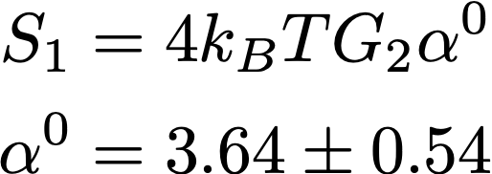
2nd order term
Fig1
Electron Temp = 125mK
Conductance
2nd order term
(Blue)
Noise PSD@3MHz
2nd order term
(Red)
DC Bias
local linear resistance:
dI/dV = G1+G2 V
FDT: S = 4 kB T (G1+G2 V)
From the FDT, we expect
𝛼0 = 1
but the measurement gave
𝛼0 = 3.64
Noise PSD@3MHz
Conductance

Slide 7






2nd order term
Fig2 ~ raw measurement ex.1
Dependence of the current noise on the bias voltage
"negative excess noise"
fitting
window
V-I curve is almost linear
But has slight curvature
(note that the plot is x20 magnified)
7

Slide 8



2nd order term
Fig2 ~ raw measurement ex.2
Dependence of the current noise on the bias voltage
fitting
window
VI curve is almost linear
But has slight curvature
(note that the plot is x20 magnified)
8

Slide 9
Magnetic Flux applied
Symmetric G1(B) = G1(-B) => OC reciprocity & equilibrium
Fig3
4 kb T G₁G1
Linear
Term
(FDT)
Hmm, where is
𝛼0 = 3.64 ???
2.69 x
4 kb T G^{S}₂
Theory:
2 kb T G^{S}₂
2nd term
(symmetric comp.)
2nd term
(antisym.
comp.)
2.18 x
4 kb T G^{S}₂
Theory:
6 kb T G^{S}₂
G2(B) = G2(-B) no longer valid
=> non-equilibrium regime
9

Slide 10



Reason of correlation
P3
Current = electron transport
Themal eq.: P(Q) = P(-Q)
Non-thermal eq: P(Q) != P(-Q)
but still the electron transport is dictated by fluctuation theorem
https://doi.org/10.1103/PhysRevLett.71.2401
10

Slide 11
T varied( with B varied)
Fig4
Theory
Theory
Linear Term (FDT)
2nd term
(sym. comp.)
2nd term
(antisym. comp.)
...so not everything was understood
11

